Slide 1


Tools & Strategies for Consuming APIs
Notes:
Hi, my name is Tonya Cooper. I'm a Software Engineer at Quicken Loans. I've worked there for a year and a half. Before Quicken, I worked for an organization developing online banking software. How many of you pay your bills online? (expecting everyone). Yes, of course, all of you, or nearly all of you. You were my end users. I spent a few of my years at that organization working on integrating 3rd party bill pay APIs into online banking applications. Today I'm going to share with you what I learned from those projects and how I made it all work together.

Slide 2


Notes:
Quicken Loans is based in Detroit, MI. I work remotely from where I live in Grand Rapids, MI. Beer City, USA. We have over 30 breweries within the city, including Founders Brewing Co. I've been a mug club member there for almost 15 years.

Slide 3
Notes:
So when I started working at Quicken and spending more time in Detroit, I found myself right at home with a bunch of great breweries, including Founder's, who opened a second taproom in Detroit in 2017. Because Founders, Quicken Loans and I all agree - Detroit is the cool place to be.

Slide 4
Third-Party Web APIs
Types of APIs
Common components
Integration Tools
Coding strategies
Communicating with owner
Beer
Notes:
We're talking today about consuming third party web APIs. We will look at different types of APIs, because often, when you are on the consuming end, that decision has been made for you - you have to use what you're given, or what's available. We will discuss some common components that you will likely run into and need to consider in your integrations. Tools that will make your life easier. We'll talk about some coding strategies. And a few tips on communicating with the API owner during development. Oh, and beer. We're going to talk about beer. We're actually building a web application that will tell our users what's currently on tap at breweries around town. We're going to need to consume a beer API. More on that later.

Slide 5
API Types
Notes:
Let’s take a look at different API types.

Slide 6
API types
RPC (remote procedure call)
REST (representational state transfer)
SOAP (simple object access protocol)
Notes:
The main types of APIs are
RPC
REST
SOAP
RPC can be XML-RPC or JSON-RPC
These categories aren't straight-forward. XML-RPC could be considered a subset of SOAP. RPC and SOAP are protocols, whereas REST is an architecture style, not a protocol.
How many of you primarily consume REST APIs?
SOAP?
Ok, well we will look at the difference of these in terms of how we make calls to them, and what the responses might look like.

Slide 7
If we want beer…
RPC | REST
/GetAllBeers | /beers
/GetBeer?beerid=001 | /beers/001
Notes:
Here is an example of how the endpoints for RPC and REST could look like if we are integrating a beer API into our application. Notice that the RPC calls are verb-oriented. They describe the action that we're taking. The REST calls are noun-oriented, and very uniform. RPC calls use GET and POST, whereas the REST ones also use PUT and PATCH for an update to an item and DELETE for removing an item.

Slide 8
Response Types for RPC and REST
Json
XML
PHP
Notes:
Looking at some common response types, does anyone use web APIs with any other response type? Okay, now let’s look at some responses.

Slide 9
[
{
"Id": "1",
"Name": "Red Eye Rye",
"Style": "Rye",
"Abv": "6.7%",
"BreweryId": "10003"
},
{
"Id": "2",
"Name": "Poetic Pestilence",
"Style": "India Pale Ale",
"Abv": "11%",
"BreweryId": "10004"
}, …
Notes:
Here's an example of a response for beer in a json format. It's pretty easy to read.

Slide 10
<?xml version="1.0" encoding="ISO-8859-1"?>
<root>
<beers>
<beer>
<id>1</id>
<name>Red Eye Rye</name>
<style>Rye</style>
<abv>6.7%</abv>
<breweryId>10003</breweryId>
</beer>
<beer>
<id>2</id>
<name>Poetic Pestilence</name>
<style>India Pale Ale</style>
<abv>11%</abv> …
Notes:
Here's the same response in XML format. Still pretty easy to read, but it has additional elements. But most of us are pretty familiar with XML.

Slide 11
a:1:{
s:5:"beers";
a:50:{
i:0;
a:5:{
s:2:"Id";
s:1:"1";
s:4:"Name";
s:11:"Red Eye Rye";
s:5:"Style";
s:3:"Rye";
s:3:"Abv";
s:4:"6.7%";
s:9:"BreweryId";
s:5:"10003"; …
Notes:
And here is the same response in PHP. I'm not a PHP developer, but like the XML, you can see what's going on

Slide 12
/beers?format=json
[
{
"Id": "1",
"Name": "Red Eye Rye",
"Style": "Rye",
"Abv": "6.7%",
"BreweryId": "10003"
},
{
"Id": "2",
"Name": "Poetic Pestilence", …
Notes:
I've worked with some APIs that allow you to set the response type in the request. Most will only return one type.

Slide 13

If we want beer with SOAP…
Soap Envelope
Request
Soap Envelope
Response
Notes:
Now, let's look at a SOAP request and response. SOAP APIs might be outdated, but there are still plenty out there. SOAP requests and responses are wrapped in a SOAP envelope.

Slide 14
<soapenv:Envelope xmlns:soapenv="http://schemas.xmlsoap.o
<soapenv:Header/>
<soapenv:Body>
<tem:GetAllBeers>
<tem:getAllBeersRequest>
<beer:BaseRequest>
<beer:APIKey>ILoveBeer</beer:APIKey>
<beer:ClientCode>TonyaZen</beer:ClientCode
<beer:RequestId>b9fa635a-6e0d-4de6-9431-ac
<beer:Version>1.02</beer:Version>
</beer:BaseRequest>
</tem:getAllBeersRequest>
</tem:GetAllBeers>
</soapenv:Body>
</soapenv:Envelope>
Notes:
The request here is fairly verbose

Slide 15
<soapenv:Envelope xmlns:soapenv="http://schemas.xmlsoap.o
<soapenv:Header/>
<soapenv:Body>
<tem:GetAllBeers>
<tem:getAllBeersRequest>
<beer:BaseRequest>
<beer:APIKey>ILoveBeer</beer:APIKey>
<beer:ClientCode>TonyaZen</beer:ClientCode
<beer:RequestId>b9fa635a-6e0d-4de6-9431-ac
<beer:Version>1.02</beer:Version>
</beer:BaseRequest>
</tem:getAllBeersRequest>
</tem:GetAllBeers>
</soapenv:Body>
</soapenv:Envelope>
<beer:APIKey>ILoveBeer</beer:APIKey> <beer:ClientCode>TonyaZen</beer:ClientCode
<beer:RequestId>b9fa635a-6e0d-4de6-9431-ac
<beer:Version>1.02</beer:Version>
Notes:
But here we're just passing in some basic information to Get Beer.

Slide 16
<s:Envelope xmlns:s="http://schemas.xmlsoap.org/soap/enve
<s:Body>
<GetAllBeersResponse xmlns="http://beerexample.com/
<GetAllBeersResult xmlns:a="http://schemas.datac
<a:BaseResponse>
<a:DisplayErrorMessage i:nil="true"/>
<a:RequestId>b9fa635a-6e0d-4de6-9431-acee1
<a:RequestTimeStamp>2019-02-14T21:01:19.15
<a:ResponseStatus>Success</a:ResponseStatu
<a:TechnicalErrorMessage i:nil="true"/>
</a:BaseResponse>
<a:Beers xmlns:b="http://schemas.datacontract
<b:Beer>
<b:Abv>6.6%</b:Abv>
<b:Brewery>Founder's Brewing Co.</b:B …
Notes:
And here's what that soap response looks like.

Slide 17
API Components
Notes:
Now that we’re familiar with how requests and responses look for different types of APIs, let’s talk about some common components of APIs that you will likely run into and how to handle them.

Slide 18
API components
Pagination
Filtering
Security
Notes:
Some, but not all APIs, have options for pagination and filtering. And most APIs implement some strategy for security. Specifically, we'll talk about authentication and authorization.

Slide 19

Large datasets
Notes:
Both pagination and filtering might be used to handle large datasets

Slide 20
Large datasets
Conserve resources
Notes:
These techniques allow you to conserve resources like bandwidth and memory.

Slide 21
Large datasets
Conserve resources
Improve response time
Notes:
They can improve your response time by returning smaller chunks of data at a time

Slide 22
Large datasets
Conserve resources
Improve response time
/beer?page=3
Notes:
There's a few different ways you might interact with pagination through an API you're integrating. Some APIs might force a "size". Meaning you can ask for any page, but you'll always get a set of, say, 50 or 100 in your response. Your request is just going to specify a page in this case.

Slide 23
Large datasets
Conserve resources
Improve response time
/beer?page=3
/beer?page=3 &size=100
Notes:
Better APIs will allow you to ask for a specific page and set the page size.

Slide 24
Large datasets
Conserve resources
Improve response time
/beer?page=3
/beer?page=3 &size=100
/beer?firstItem=300&size=100
Notes:
Another approach is an offset scheme. In this approach, you provide a starting item and the number of items you want back in the response. Additionally, some APIs allow you to indicate how you want the result set sorted. There might be defaults to pagination results if you don't provide it in the request. If an API supports pagination, it should include pagination metadata in the response, like number of items in the response and total number of items available. A good REST API might include links to the next and previous page.

Slide 25


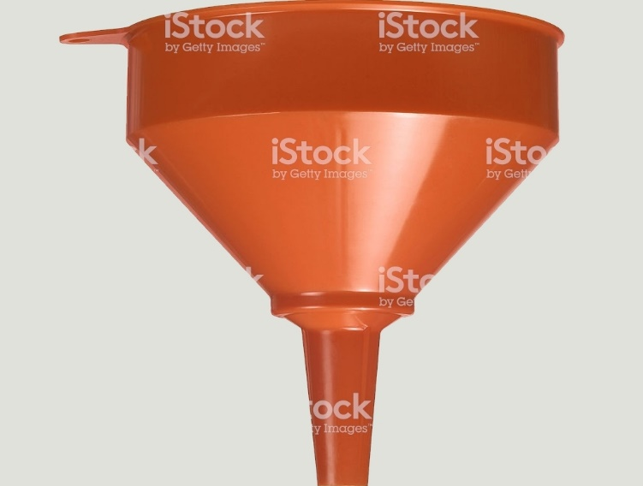
/beer?style=stout
Notes:
Filtering has the same benefits of pagination. An API may allow you to filter on one or more category to limit the result.

Slide 26
Authentication & Authorization
Username / Password
API Key
Token
Session Id
Notes:
Authentication and Authorization aren't the same thing. Authentication is verifying who you are, and authorization is verifying you are allowed access to a resource. Username and Password are used for authentication. An API Key can be used to both authenticate and authorize. A token or session ID are typically provided after some sort of authentication and used to authorize the requests. The API should be using one or a combination of these to both authenticate and authorize you. Their documentation should specify exactly how this is done.

Slide 27

Notes:
You might feel like Steve Carell in the passenger seat. And your driver just might be drunk. If you've integrated APIs from a variety of vendors, you have likely ran into a poorly developed one. Or at least one with poor documentation.

Slide 28
Integration Tools
Notes:
Recognizing those components and understanding how they are typically used will get you up to speed faster. Next, let’s look at Integration Tools. Being able to make calls to the APIs and see exactly what the responses look like outside of our applications can be of great assistance in our integrations.

Slide 29


Tools
Notes:
There are a ton of tools out there. Some of them are more geared toward developing APIs. I primarily use Postman for REST APIs and SOAPUI for SOAP APIs. They are both free. Let’s look at these now.

Slide 30
Tools
Demo
Notes:
There are a ton of tools out there. Some of them are more geared toward developing APIs. I primarily use Postman for REST APIs and SOAPUI for SOAP APIs. They are both free. Let’s look at these now.

Slide 31
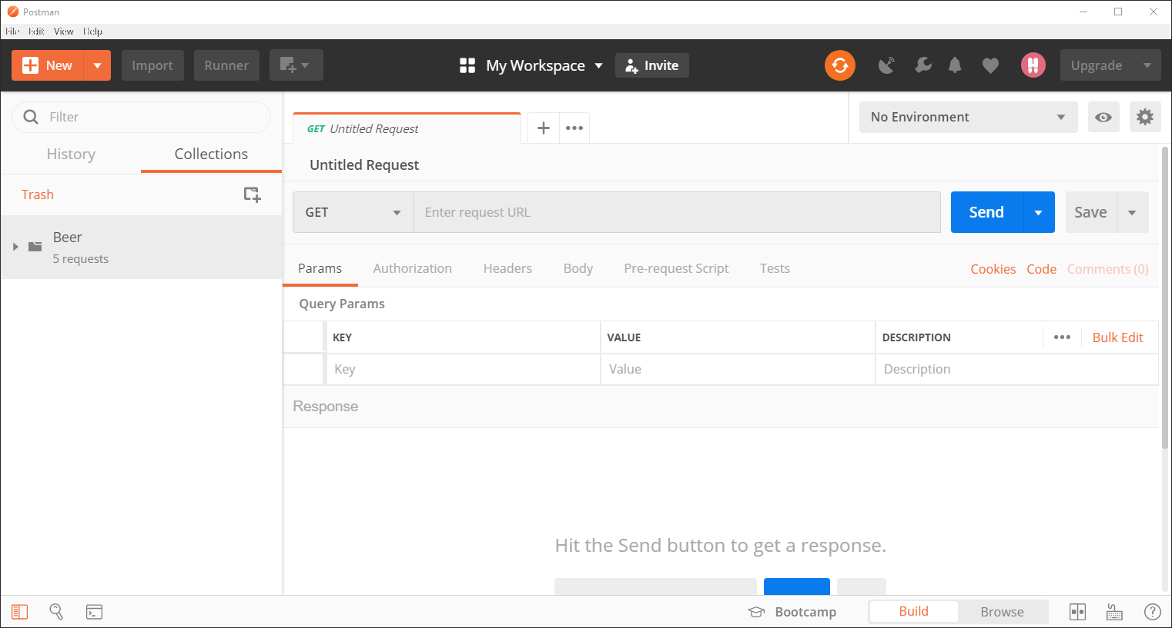
Notes:
Here we have Postman. It’s okay if you can’t see all the details. We’re just going to walk through how I use this tool for making requests, examining responses and mocking APIs.

Slide 32
Notes:
The first thing I do in Postman is set up environments. Most API providers will have at least two environments: a test and a production environment. These environments will require different URLs, credentials, and parameters. Postman allows us to set these up as variables.

Slide 33
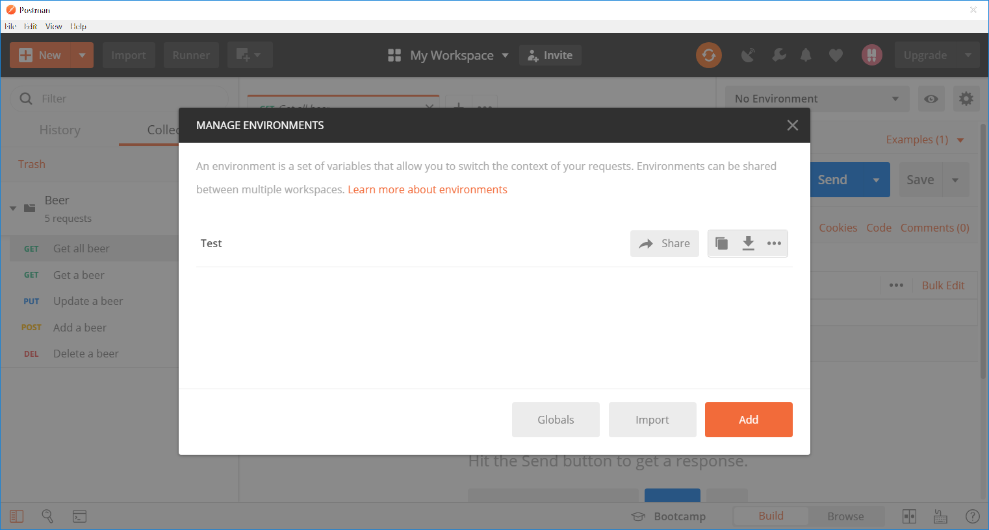
Notes:
So far I have configured a Test environment. Here I can add additional ones.

Slide 34
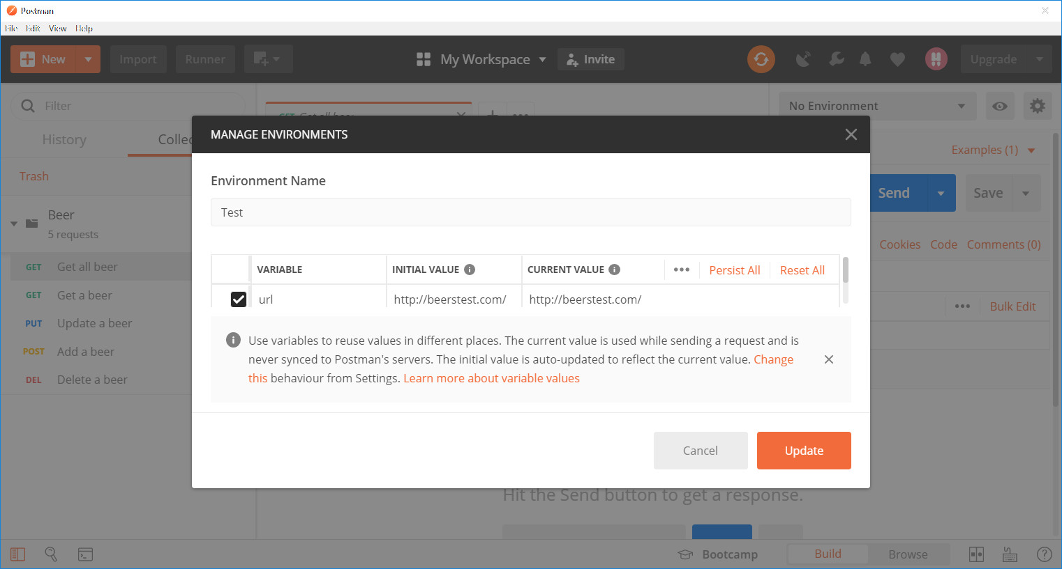
Notes:
In our test environment, I have configured a variable for the api url.

Slide 35
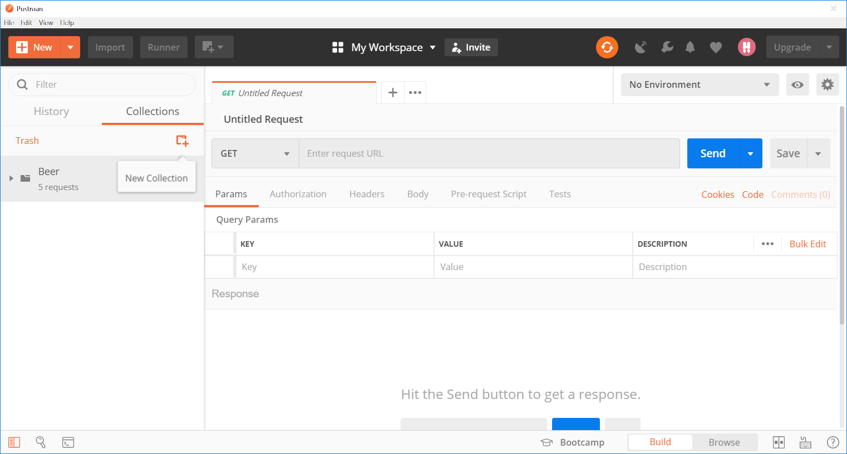
Notes:
I already have a Beer collection, but this is where we can add new collections. I organize collections by API. This is a beer API, so all the endpoint calls I make to that API are within that collection. If next I integrate a Brewery API, I’d add a Brewery collection and place all the calls to that API under that collection. But you can organize your Collections and endpoints any way you find helpful.

Slide 36
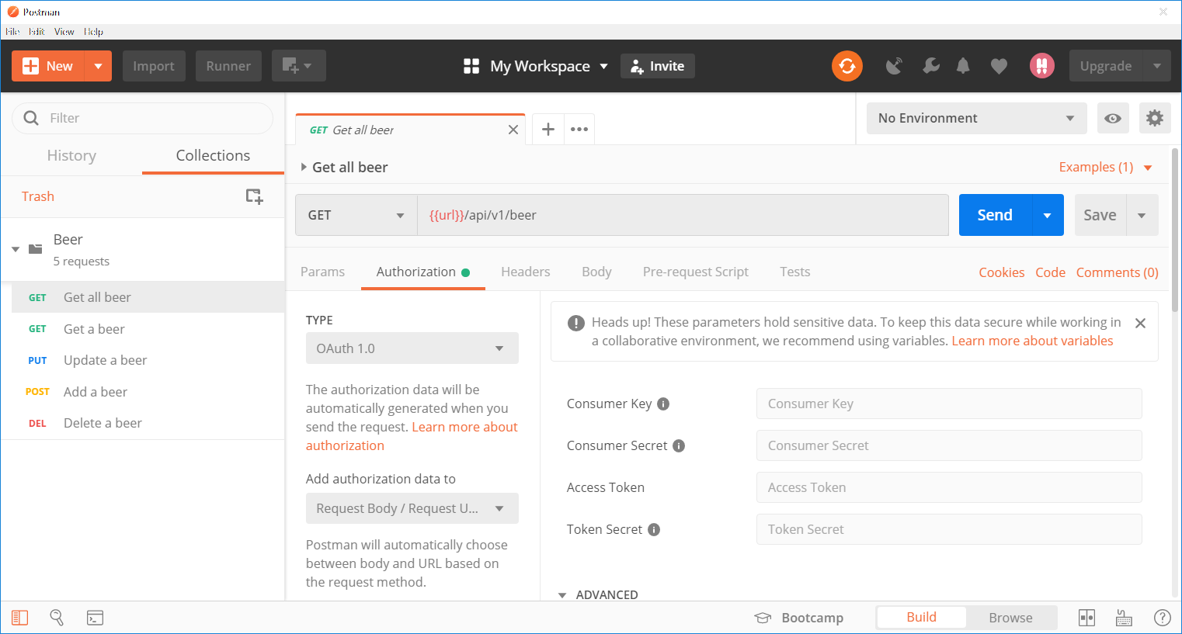
Notes:
The Authorization tab is where you can configure Authentication and Authorization if the API uses something like Basic Auth or Oauth.

Slide 37
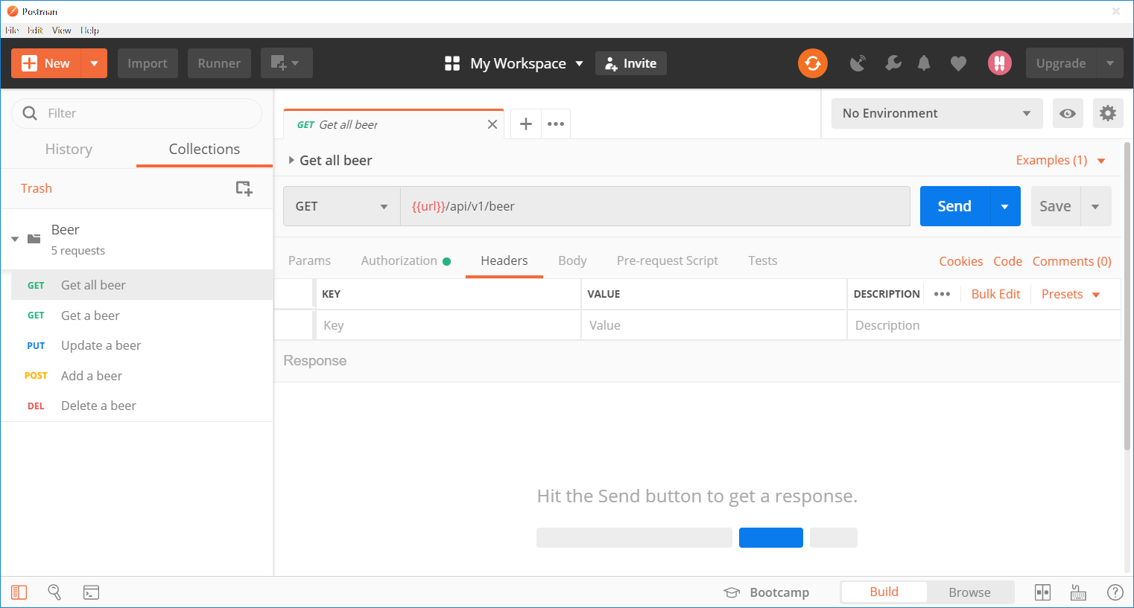
Notes:
If the API accepts something like a token or client ID in the headers, you can configure that here. When you are sending a body with a request, you can set the Content-Type header here.

Slide 38
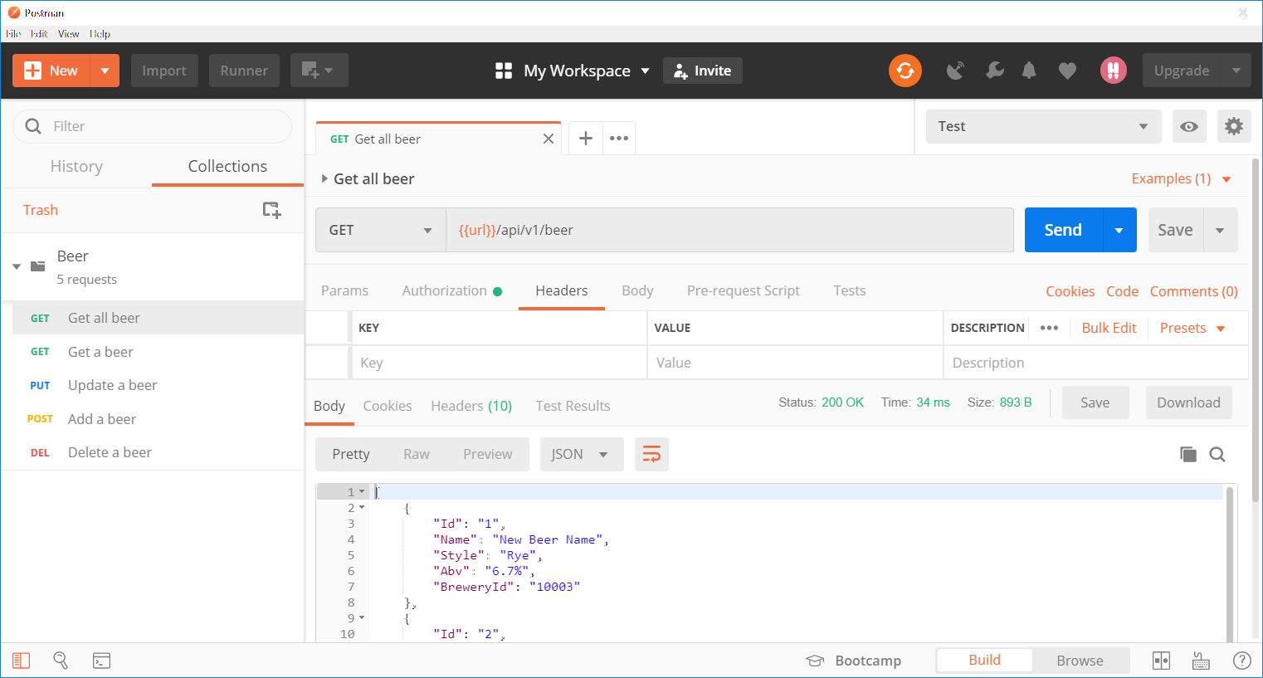
Notes:
We’re using our environment variable in the GET URL since it’s environment specific.

Slide 39
Notes:
Once we’ve entered all the info for the request, we can Save the request to our Collection. In the future when we want to make that request again, all we have to do is choose it from the Left under the collection and hit send. When we click Send, the response is displayed in the bottom pane. Now we know exactly what our response is going to look like.

Slide 40
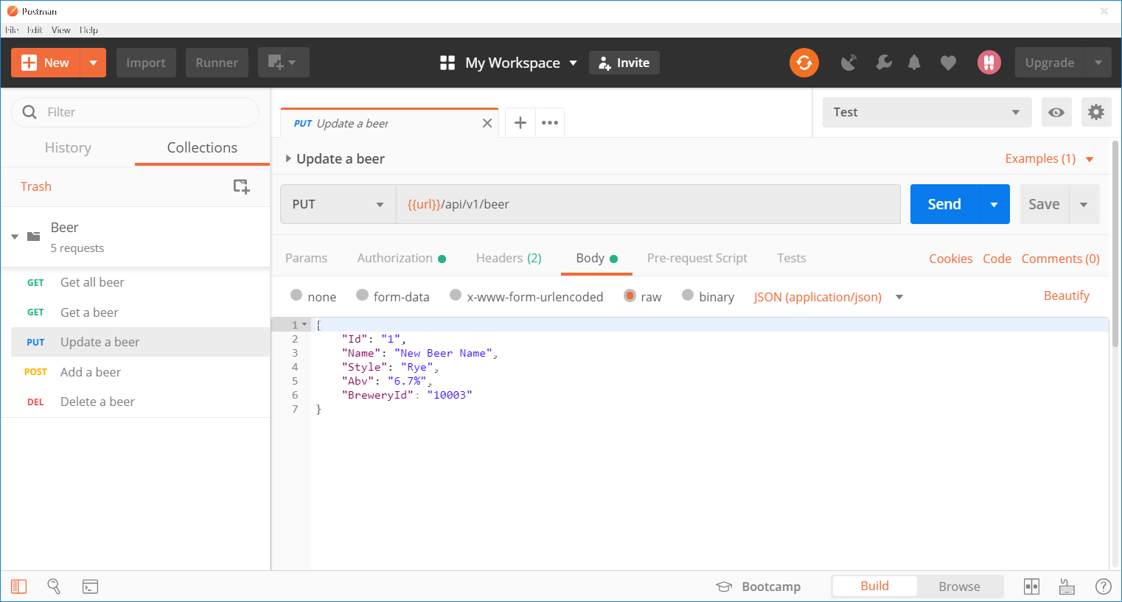
Notes:
Here is an example of an update request. It requires a beer object to update which we include under the Body tab.
So that’s how I use Postman to send requests and inspect the responses. The other thing I use Postman for is mocking the API. Mocking allows us to continue development even if our vendor’s test environment is down. I’ve had development stalled because of test environments being unavailable, so now I do this step as soon as I have access to the test environment.

Slide 41
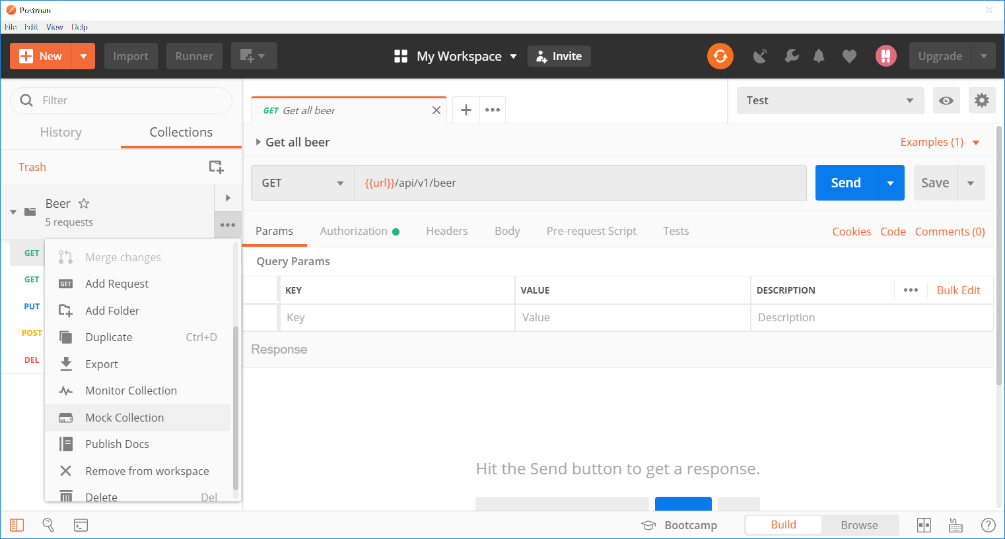
Notes:
To set up a mock, click on the Collection ellipsis and choose Mock Collection.

Slide 42
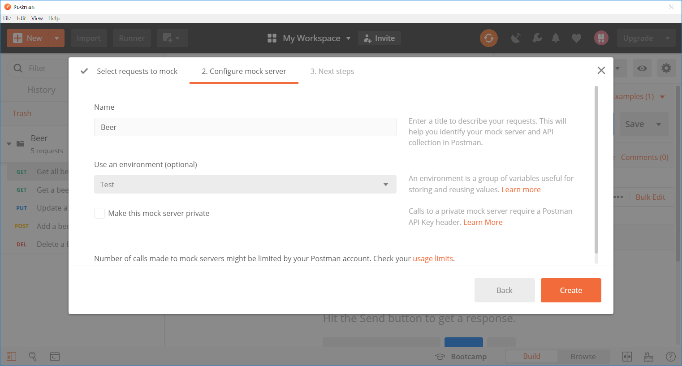

Slide 43
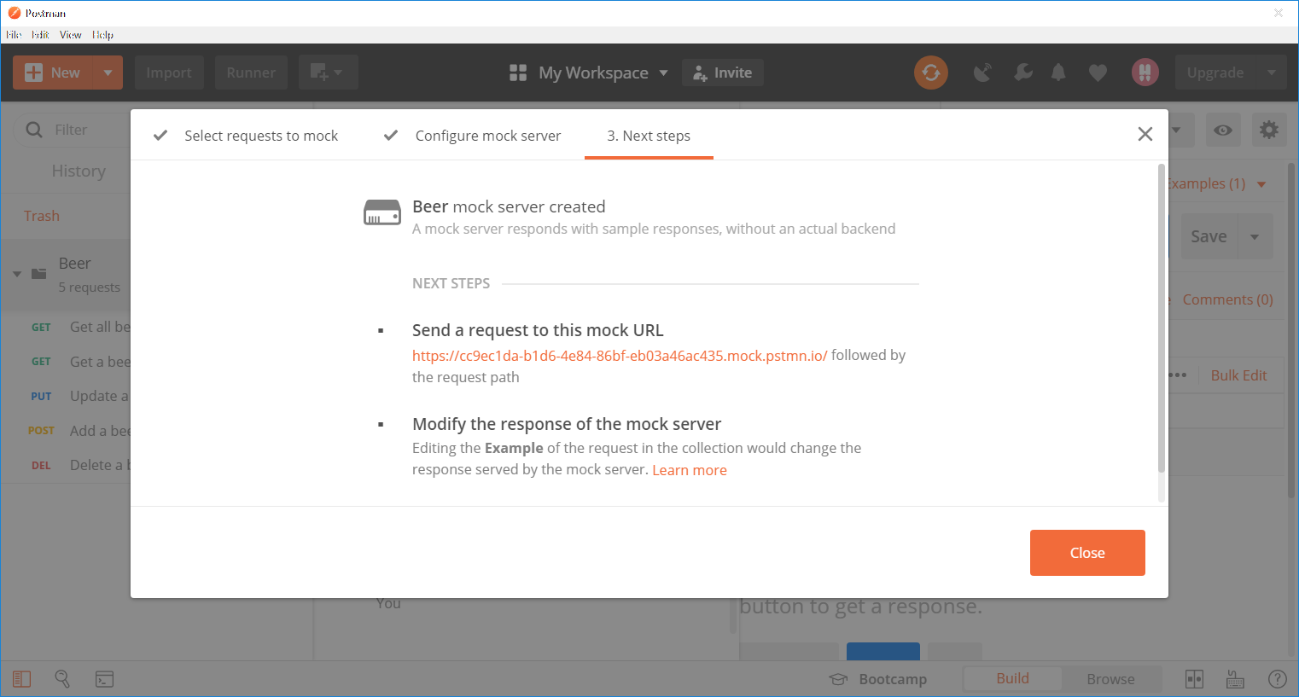
Notes:
Once setup, Postman provides you with a mock url for the requests. This URL can be used inside Postman to send mock requests, but it can also be configured in Visual Studio to develop against a Mock service.

Slide 44
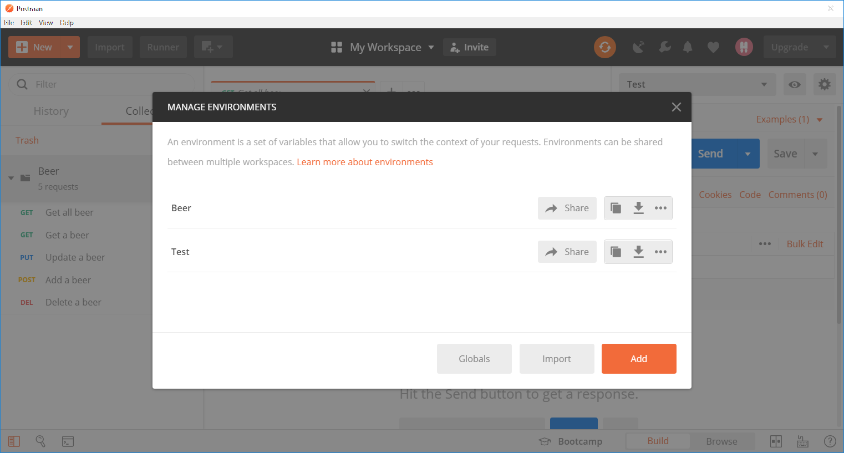
Notes:
Postman automatically adds an environment for the mock service.

Slide 45
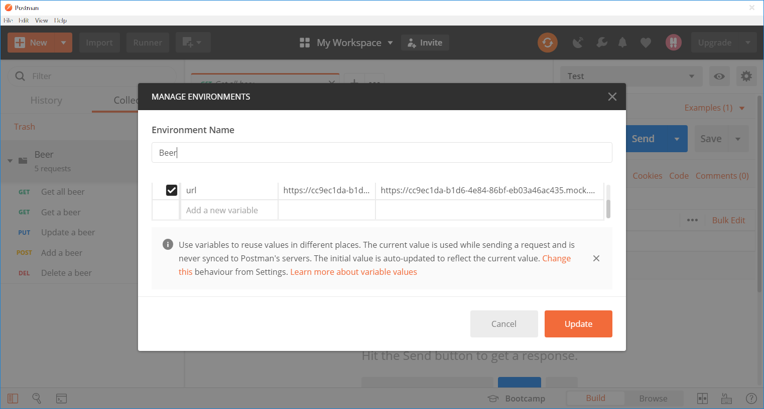
Notes:
And it automatically assigns the URL to the URL variable for you.

Slide 46
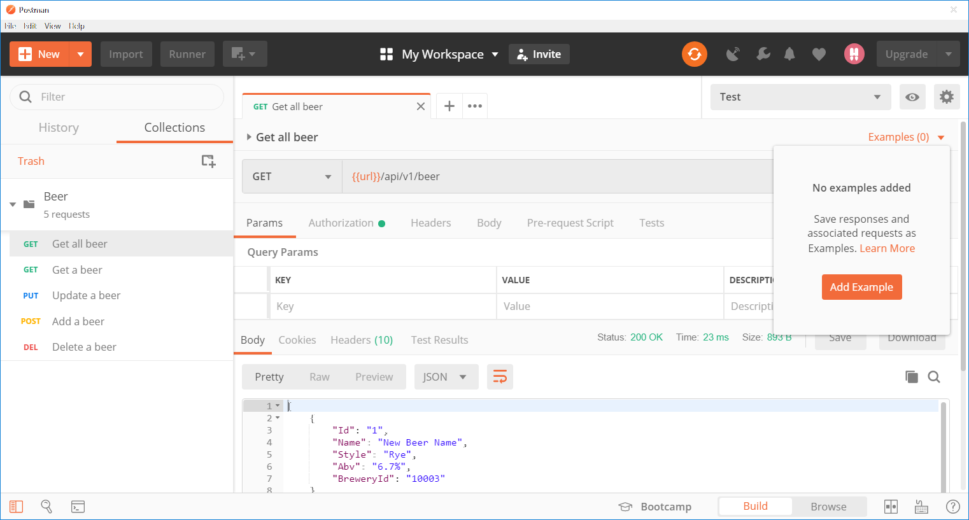
Notes:
Now that we have a mock service, we need to create examples so that when we send a mock request, it knows what dataset to return. I’ve already sent a request to the endpoint that Gets all the beer. I have the response in the bottom pane. All I have to do is add the example.

Slide 47
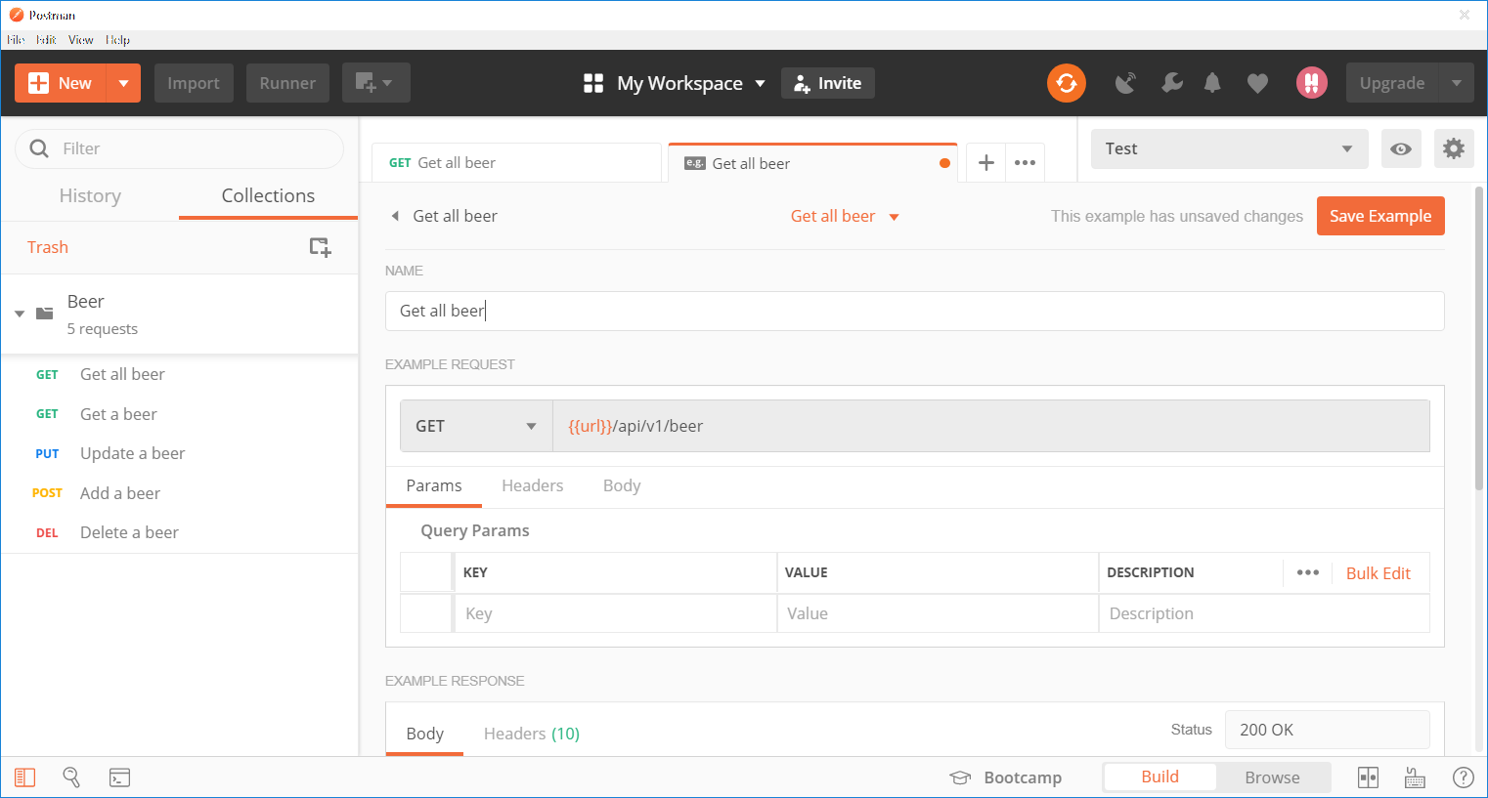

Slide 48
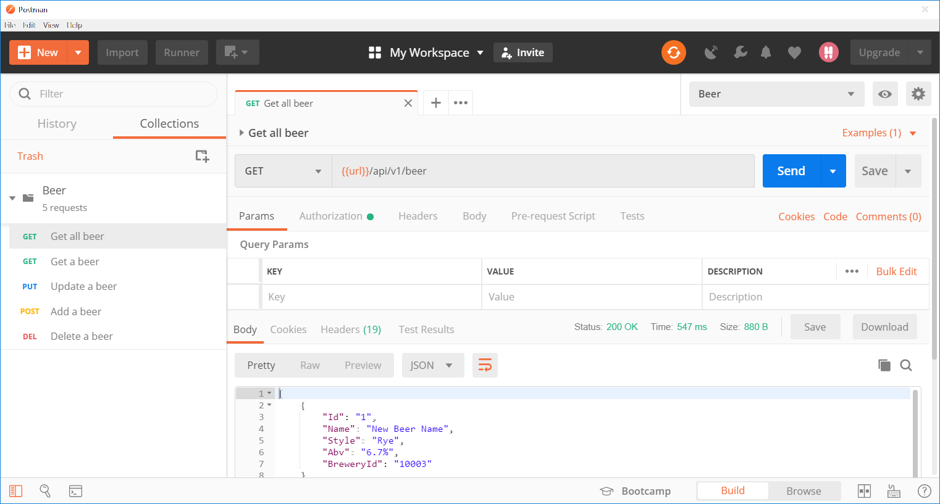
Notes:
Now if I change the environment to our Beer environment, which is our Mock Service, I can send a request and get the response that I saved as an example. If the test environment is unavailable for some reason, I have this Mock Service as a backup and can continue development without interruption. So that’s how I use Postman for sending and inspecting responses and using a mock service.

Slide 49
private readonly HttpClient _client = new HttpClient();
public async Task<BeersResponse> GetAllBeers()
{
using (_client)
{
_client.BaseAddress = new Uri(_baseAddress);
_client.DefaultRequestHeaders.Accept.Clear();
_client.DefaultRequestHeaders.Accept.Add(
new MediaTypeWithQualityHeaderValue("application/json"));
try
{
var response = await _client.GetAsync(_beerPath);
…
}
catch(Exception ex)
{
Notes:
Now you probably need to decide how you’re going to call the REST API. If you’re a .NET developer, you have four basic choices: HttpWebRequest, WebClient, RestSharp or HttpClient. I am typically using HttpClient because of the async features and it’s made for the .NET 4.5 platform, which is what I’ve been working in. Just know that there are options and you will want to decide what’s going to work best for your project.
Regardless of which of those four you choose, you should include a using statement to dispose of your web request objects properly.
Now let’s look at SOAPUI.

Slide 50
Tools
Demo
Notes:
There are a ton of tools out there. Some of them are more geared toward developing APIs. I primarily use Postman for REST APIs and SOAPUI for SOAP APIs. They are both free. Let’s look at these now.

Slide 51
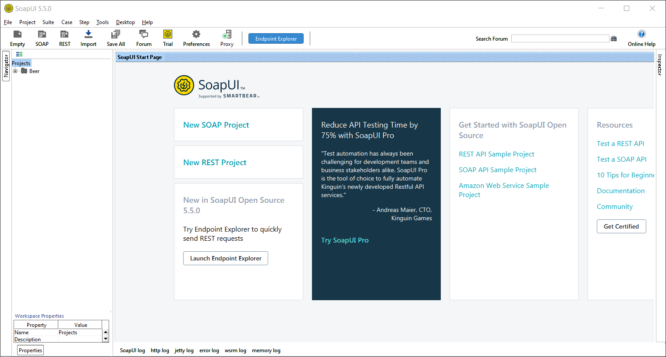
Notes:
This is SOAP UI – and again, don’t worry if you can’t see all the details because we’re just going to do the same walk throughs as we did in Postman – we’re going to look at how to send requests and use a mock service. On the home page, we can get started by clicking New SOAP Project.

Slide 52
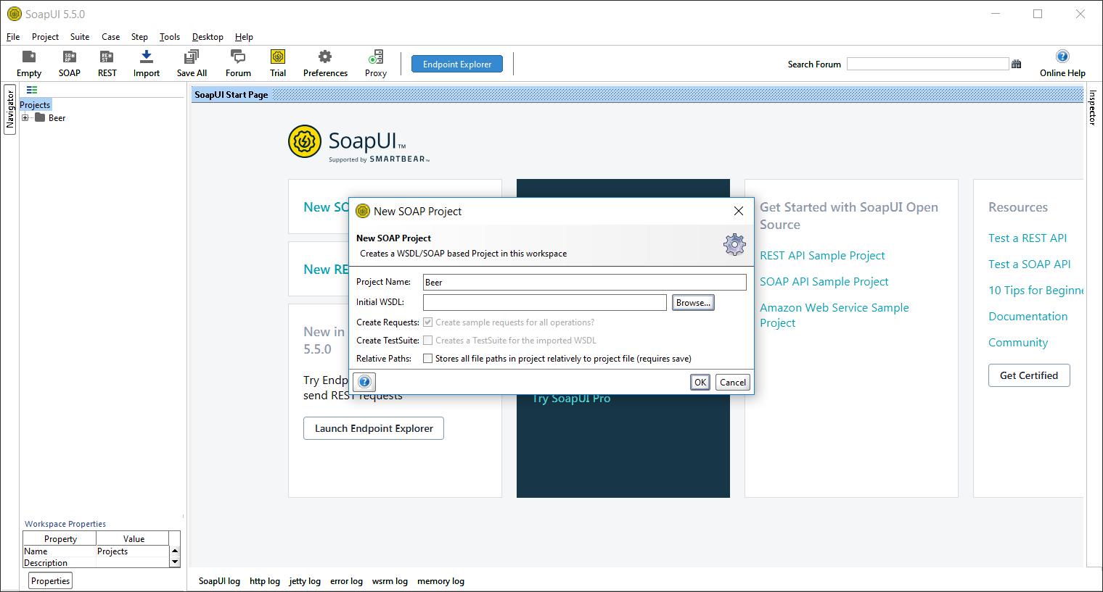
Notes:
WSDL stands for Web Service Description Language. It’s an XML document that describes the API. You might get a physical file or a web address that you can import in both SOAP UI and Visual Studio. Here you will give your project a name and enter the WSDL location.

Slide 53
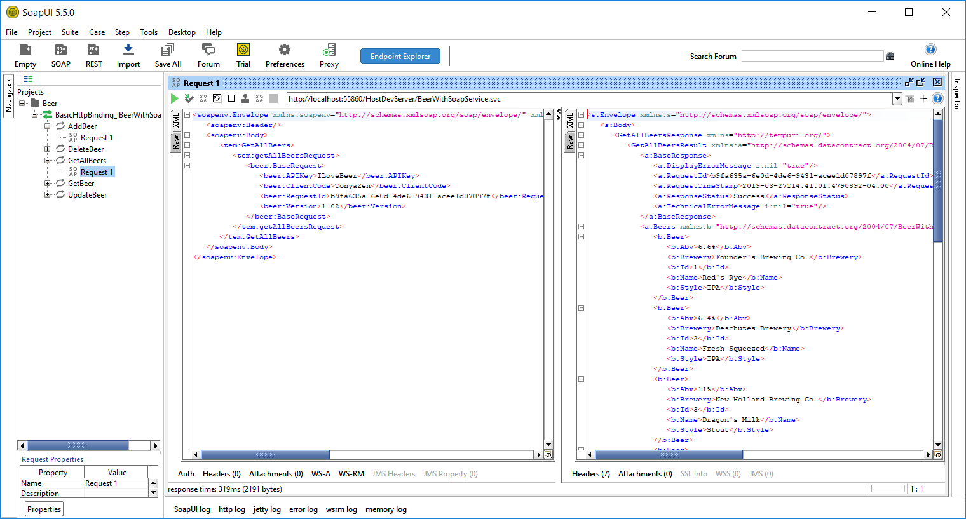
Notes:
Once the WSDL is imported, SOAPUI creates a Project with the name you provided. It organizes each endpoint under a corresponding Interface defined in the WSDL. Our API only has one interface. For each endpoint, SOAPUI adds a single request. You just click on a request and fill in the criteria and send it. The Response will be displayed in the Right pane.
You can add multiple requests for each endpoint.

Slide 54
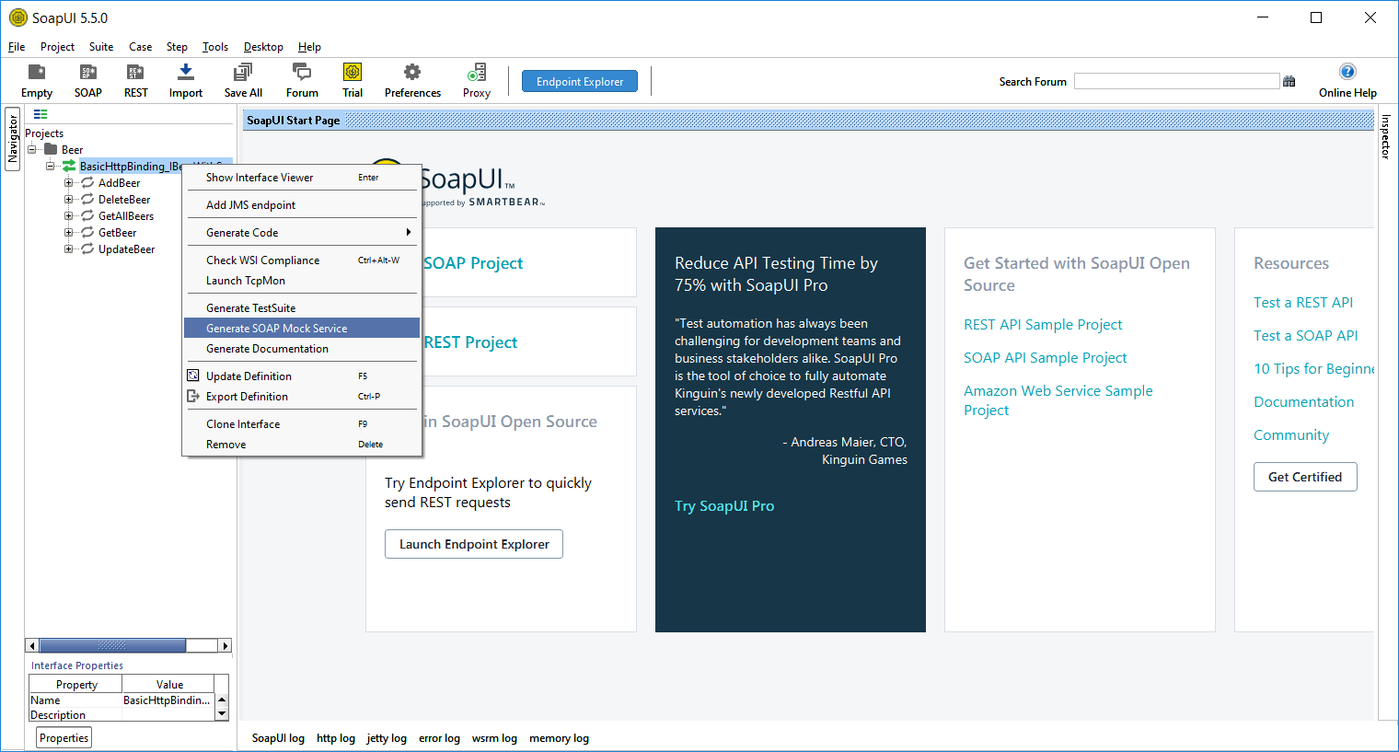
Notes:
To create a Mock Service in SOAPUI, Right click on the Project interface and choose Generate SOAP Mock Service.

Slide 55
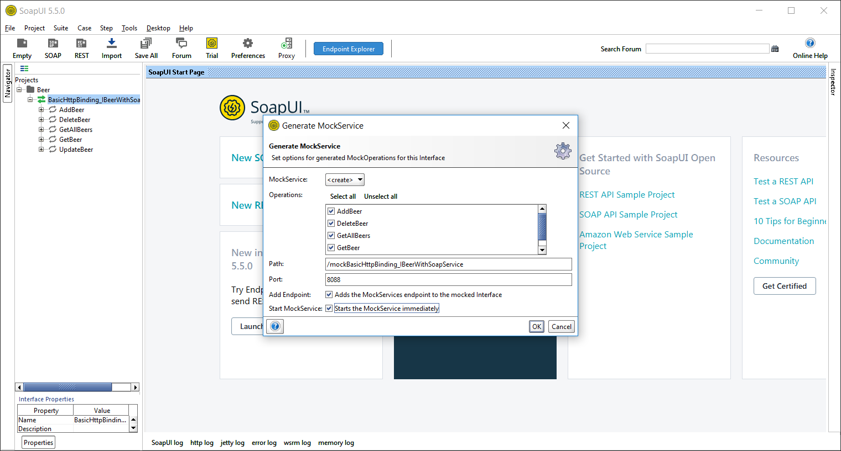

Slide 56
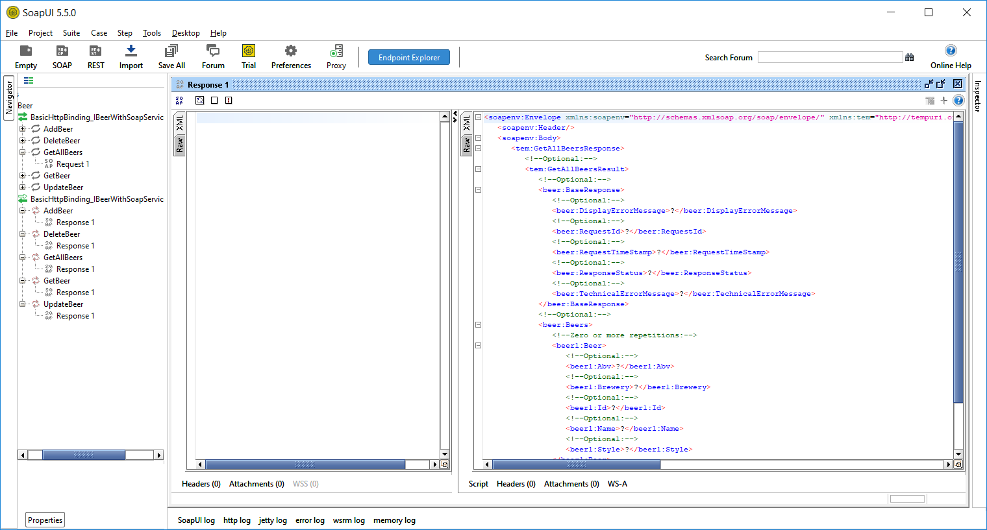
Notes:
This will add another Interface under our project for the Mock Service. It will look very similar to the normal service, but instead of Requests under the endpoints, you will see a response for each endpoint. You can edit the response manually in the pane on the right. But we can also save responses as mock responses as we did in Postman.

Slide 57
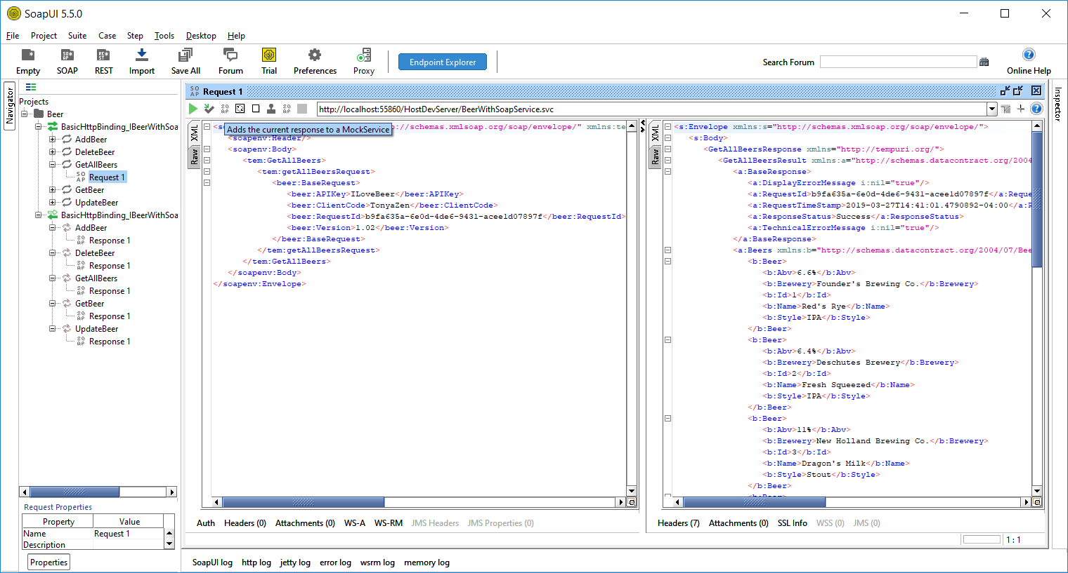
Notes:
After sending a request and receiving a valid response, we can click a button above the request that Adds the current response to a Mock Service.

Slide 58
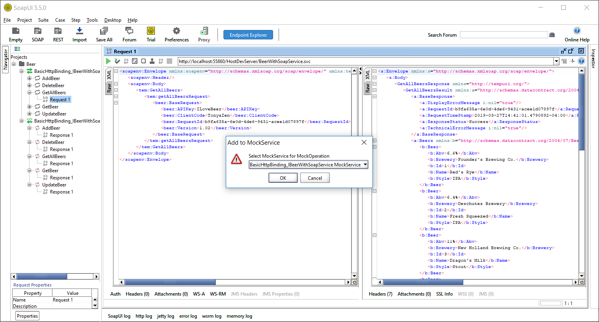

Slide 59
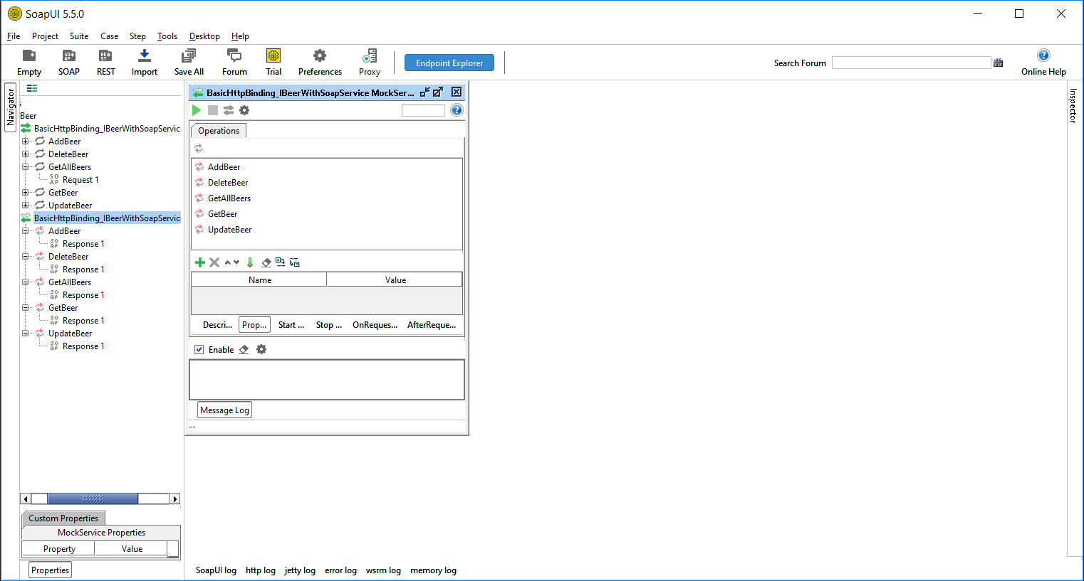
Notes:
In SoapUI we have to start the Mock Service to make requests to it. Right Click on the Interface for the Mock Service and choose Show Mock Service Editor. On the editor, click the play button to start the service. The Mock Service Editor will display what Port the service is running on. You can go to that port in your browser and navigate to the service. That will give you the WSDL URL that can be configured in Visual Studio if you wish. SOAPUI can also be used for REST APIs, and Postman can be used for SOAP APIs, but now you’ve had a look at both and can decide for yourself which tool you prefer for the job.

Slide 60
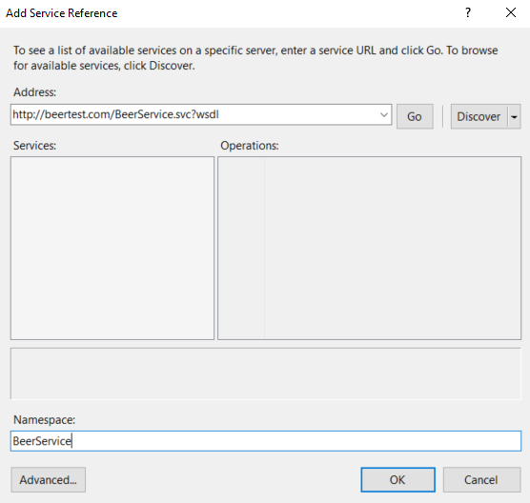
Notes:
In Visual Studio, it’s very easy connect to a SOAP API. Once you’ve created a project in your solution for the SOAP Service, Right click on it and go to Add > Service Reference. Browse to the WSDL file or enter the URL. And that’s all there is to it.

Slide 61
<system.serviceModel>
<bindings>
<basicHttpBinding>
<binding name="BasicHttpBinding_IBeerService" />
</basicHttpBinding>
</bindings>
<client>
<endpoint address="http://beertest.com/mockBasicHttpBinding_IBe
binding="basicHttpBinding"
bindingConfiguration="BasicHttpBinding_IBeerService"
contract="BeerService.IBeerWithSoapService"
name="BasicHttpBinding_IBeerService" />
</client>
</system.serviceModel>
Notes:
Visual Studio will add the service model binding to your app configuration for you.

Slide 62
public BeersResponse GetBeers()
{
BeerServiceClient client = new BeerServiceClient();
var getAllBeersRequest = new GetAllBeersRequest
{
BaseRequest = GetBaseRequest()
};
try
{
var response = client.GetAllBeers(getAllBeersRequest):
…
}
catch(Exception ex)
{
…
}
}
Notes:
And then you can reference your service in your class and start using the Beer service to make the API calls.

Slide 63
Coding Strategies
Notes:
Now Let's look at some coding strategies that will make our implementation easier.

Slide 64

Notes:
Separate your service layer where you make API calls from other code.

Slide 65
public interface IBeerServices
{
BeersResponse GetBeers();
BeerResponse GetBeer(string id);
BeerResponse AddBeer(Beer beer);
BeerResponse UpdateBeer(Beer beer);
BaseResponse DeleteBeer(string id);
}
Notes:
And Implement an interface. If you do both of these, it will make your code more testable - you'll be able to mock the service for unit tests. It will also allow you to consume more than one API using a common method signature, or swap out an API for a completely different one without touching the rest of your code.

Slide 66
public interface IBeerServices
{
BeersResponse GetBeers();
BeerResponse GetBeer(string id);
BeerResponse AddBeer(Beer beer);
BeerResponse UpdateBeer(Beer beer);
BaseResponse DeleteBeer(string id);
}

Slide 67
public interface IBeerServices
{
BeersResponse GetBeers();
BeerResponse GetBeer(string id);
BeerResponse AddBeer(Beer beer);
BeerResponse UpdateBeer(Beer beer);
BaseResponse DeleteBeer(string id);
}

Slide 68
public class BeersResponse : BaseResponse
{
public List<Beer> Beers { get; set; }
}
public class BaseResponse
{
public bool Success { get; set; }
public string Message { get; set; }
}
Notes:
Consider returning a response object from your service methods.

Slide 69
public class BeerResponse : BaseResponse
{
public List<Beer> Beers { get; set; }
}
public class BaseResponse
{
public bool Success { get; set; }
public string Message { get; set; }
}
public bool Success { get; set; }
Notes:
This way you can check if it was successful. And you'll know that your call didn't return any beer because there was nothing to return rather than because there was an error.

Slide 70
try
{
var response = beerService.GetBeers();
…
}
catch(Exception ex)
{
_logger.ErrorFormat("…");
…
}
Notes:
Wrap your API calls in Try/Catches. We don't control what happens in that API and we have to assume that plenty can go wrong. So we have to wrap our calls in Try/Catches so we can handle exceptions that are thrown.

Slide 71
_logger.ErrorFormat($“Add process failed for
client: {request.ClientCode},
requestId: {request.RequestId},
beer: {request.Beer.Name},
brewery: {request.Beer.Brewery},
exception: {ex}.");
Notes:
Set up logging right away so you're using it as you develop and debug. That way you'll know that you're logging what you need.
Does it identify the request?
Does it provide the info you need to troubleshoot?
Does it contain sensitive information that shouldn't be logged?

Slide 72
Our Object
string Id
string Name
string Abv
BeerStyle Style
string Description
bool IsOnTap
Brewery Brewery
Notes:
Define your own objects with property names and types that make sense for your application. Classes outside of your service layer should only know about your objects.

Slide 73
Our Object
API 1
string Id
string Name
string Abv
BeerStyle Style
string Description
bool IsOnTap
Brewery Brewery
long BeerId
string Name
decimal Abv
string Style
string Description
long Brewery
Notes:
Let the service layer handle the objects returned from the API.

Slide 74
Our Object
API 1
string Id
string Name
string Abv
BeerStyle Style
string Description
bool IsOnTap
Brewery Brewery
long BeerId
string Name
decimal Abv
string Style
string Description
long Brewery
Notes:
Then you're going to map the data returned from the APIs to your models. You can use a library like AutoMapper or Mapster, or write your own.

Slide 75
Our Object
string Id
string Name
string Abv
BeerStyle Style
string Description
bool IsOnTap
Brewery Brewery
Notes:
Inevitably, you're going to change vendors.

Slide 76
Our Object
API 2
string Id
string Name
string Abv
BeerStyle Style
string Description
bool IsOnTap
Brewery Brewery
string Id
string Name
string Abv
Style Style
string Description
string Brewery
Notes:
Use a different API.

Slide 77
Our Object
API 2
string Id
string Name
string Abv
BeerStyle Style
string Description
bool IsOnTap
Brewery Brewery
string Id
string Name
string Abv
Style Style
string Description
string Brewery
Notes:
Or add another vendor or API. When I was developing bill pay applications, two of the vendors were calling a bill an eBill, but another was calling it an electronic invoice. And one vendor considered an eBill part of a payment object, but another had it as part of a Payee object. So use properties in your models that make sense in your application - an industry standard or a term that is used within your organization. We know that naming is hard, so spending time on this upfront will make your life easier later.
There is a little Visual Studio Trick to creating json and xml classes in you project. You can copy an object that you got from a response in Postman or SOAP UI and in Visual Studio

Slide 78
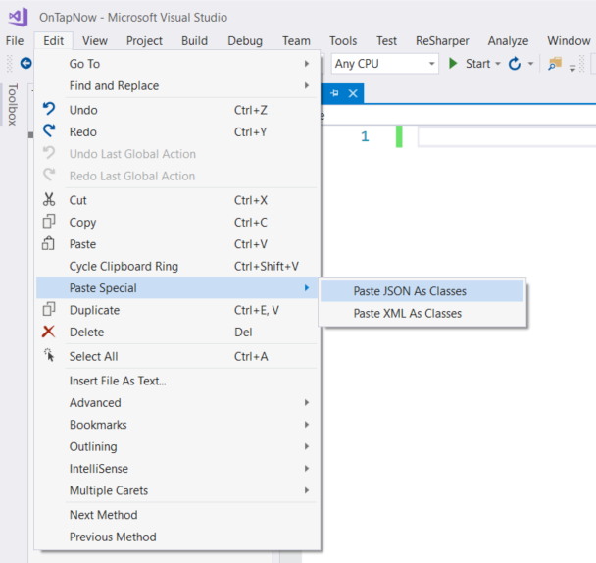
Notes:
There is a neat little Visual Studio Trick that will allow you to create a class from a json or xml object that you copy. You can copy one from a response in Postman or SOAP UI. From the Edit menu in Visual Studio, Choose Paste Special and then either JSON or XML and it will create the class for you.

Slide 79

Notes:
Store or cache results of common calls that don't change. I had one vendor that that required a certification process of our integration before turning it on in production by watching us (during a screen share) perform functions in our UI while watching their logs to make sure we didn't make any unnecessary calls. We were to only make a call when the function required it. If we had added a new payee, we could make a new call to get payees, but only if we had performed a function that would have changed that response. This can be helpful in a situation where a vendor has Rate Limiting on their API. Which means they limit the number of calls you can make in a given time.

Slide 80
Code Review
Separate service layer
Interface for your service class
Response objects
Try/Catches
Logging
Use your own objects
Cache results
Notes:
Okay, time for a little code review:
Separate your service layer
And implement an interface so your application is flexible and testable
Consider using response objects that include an indication of whether the API call was successful and can return an error message from the API.
Wrap your API calls in Try/Catches so you can handle exceptions thrown in the API
Set up logging and use it as you develop and debug
Create objects with properties that make sense in your application
Store results when you can to save on unnecessary calls to the API

Slide 81
Communicating with Owner
Notes:
This is something I don’t really hear people talk about, but it’s important.

Slide 82
Cheers to Good Communication
First… consult the documentation
Utilize their ticketing system
Provide raw request and response
Be nice
Notes:
Hopefully the API owner provided you with good documentation. Some documentation I've used has been excellent with code examples, and best practices, and suggestions on how to implement. I've seen some that only contain example requests and responses, and a lot of things in between. Just make sure that before you contact the API provider, you've read the documentation.
If the vendor has a method of opening support tickets for their API, respect the system they have in place.
Provide raw requests and responses: In my experience, this is what they want to see. If you aren't getting the response you expect, as outlined by their documentation, send them both the request and response. If they don't contain a datetime, include that as well so they can check their logs.
Be nice. Be professional. One of the bill pay vendors I worked with offered me a position on their development team. One provided me a great reference when I interviewed at Quicken Loans. Building positive working relationships with your vendors is only going to work to your advantage.

Slide 83
Drink Responsibly! Questions?

